Slide 1
Module 2: Mechanical Separations (Chapter 29)
Lecture 6
Somak Chatterjee

Slide 2
Lecture: Centrifugal Filtration and Washing Rate

Slide 3
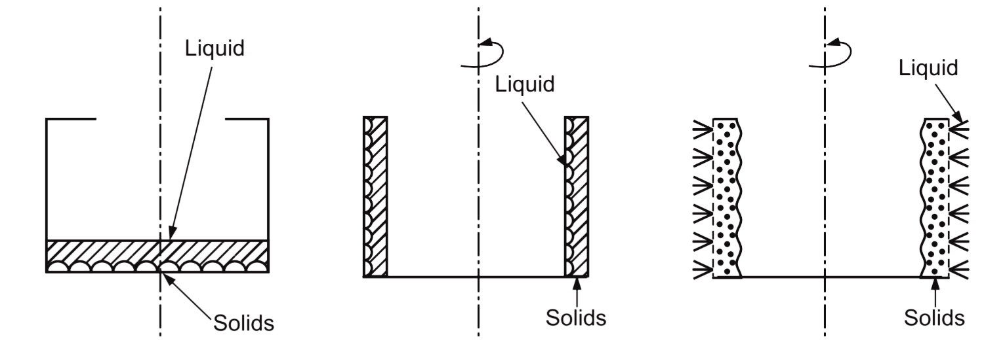
Centrifugal Filtration
Sedimentation in rotated imperforated bowl
Filtration in rotated perforated basket
Bowl is Stationary

Slide 4
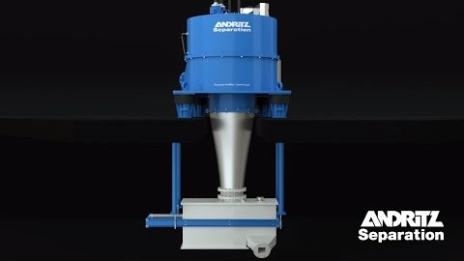
Centrifugal Filtration
https://www.youtube.com/watch?v=wg39R41EyPo

Slide 5
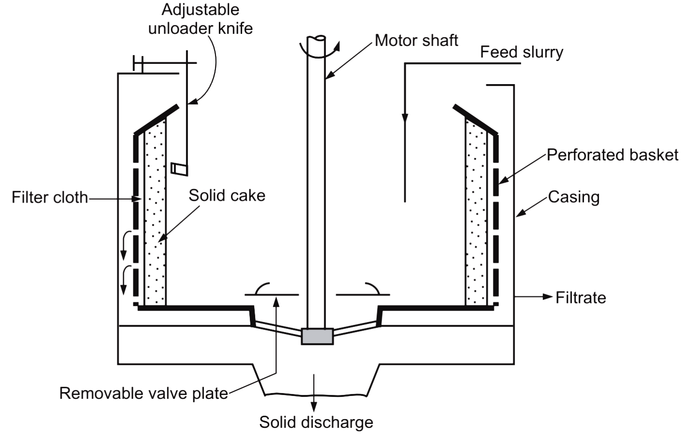
Centrifugal Filtration

Slide 6
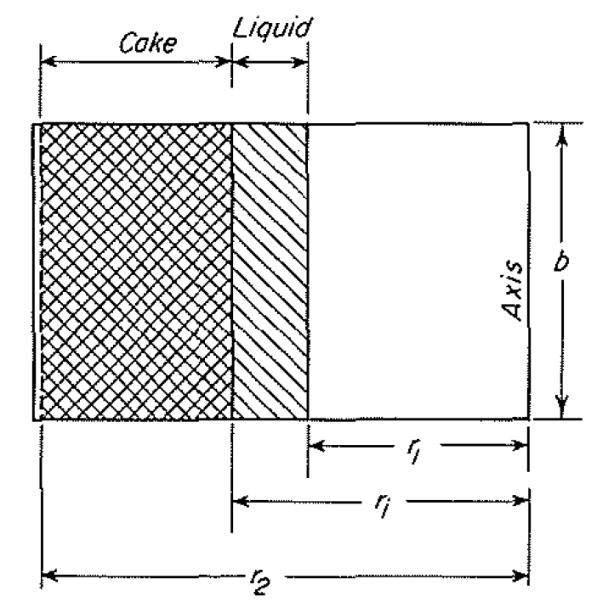

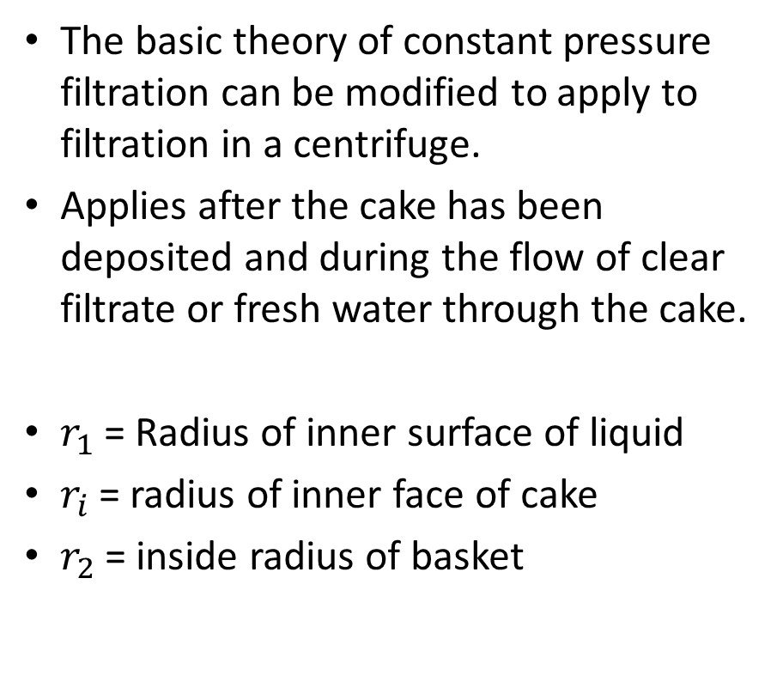




Principles of Centrifugal Filtration
Cake
Liquid
The basic theory of constant pressure filtration can be modified to apply to filtration in a centrifuge.
Applies after the cake has been deposited and during the flow of clear filtrate or fresh water through the cake.
$r_{1}$ = Radius of inner surface of liquid
$r_{i}$ = radius of inner face of cake
$r_{2}$ = inside radius of basket
$$b$$
Axis
$$r_{1}$$
$$r_{i}$$
$$r_{2}$$

Slide 7
Principles of Centrifugal Filtration
Cake
Liquid
Assumptions:
Effect of gravity & change in kinetic energy of liquid is neglected
Pressure drop from the centrifugal action equals the drag of the liquid through the cake
The cake is completely filled with liquid
Flow of liquid is laminar
Resistance of filter medium is constant
The cake is nearly incompressible.
$$b$$
Axis
$$r_{1}$$
$$r_{i}$$
$$r_{2}$$

Slide 8
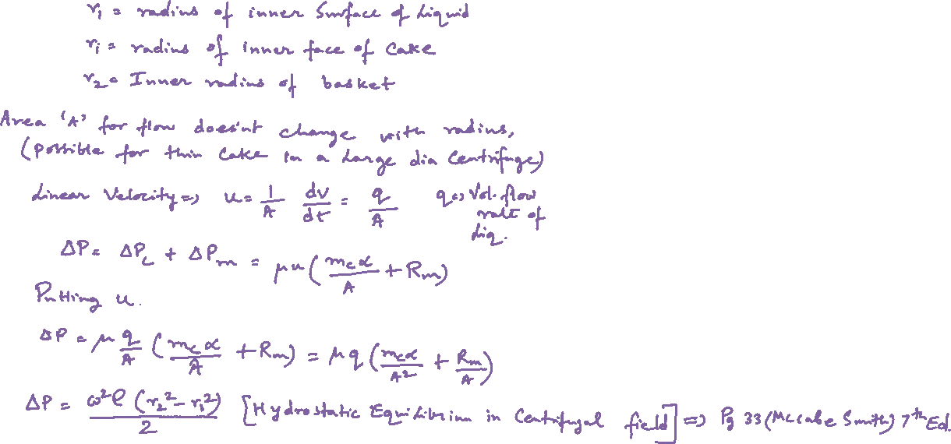
Cake
Liquid
$$b$$
Axis
$$r_{1}$$
$$r_{i}$$
$$r_{2}$$

Slide 9
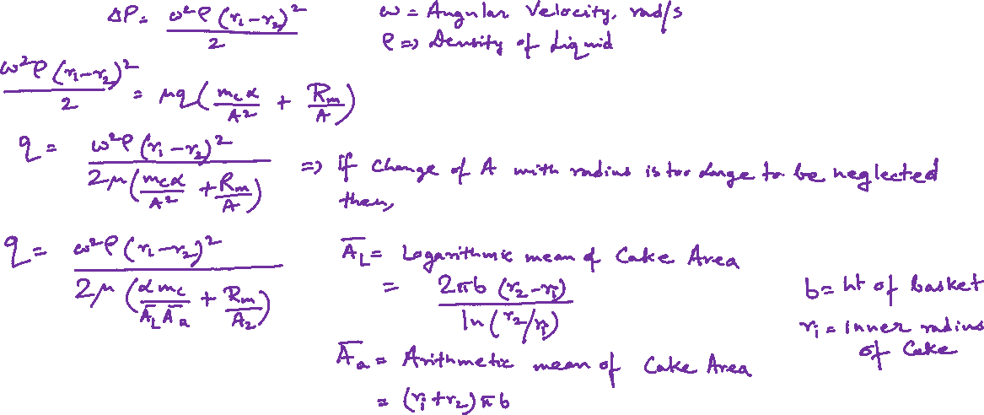

Slide 10
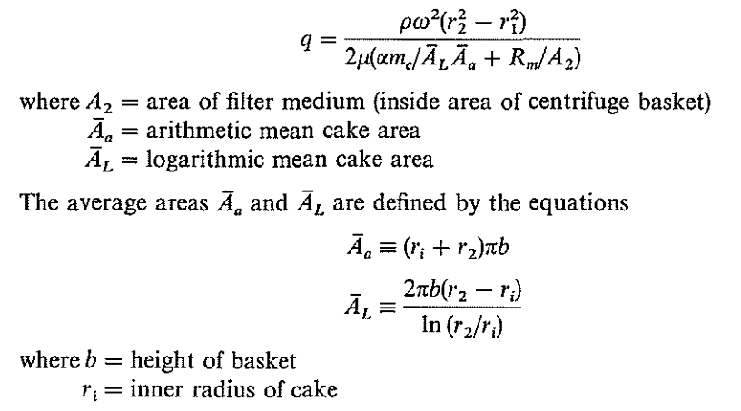
Summary

Slide 11
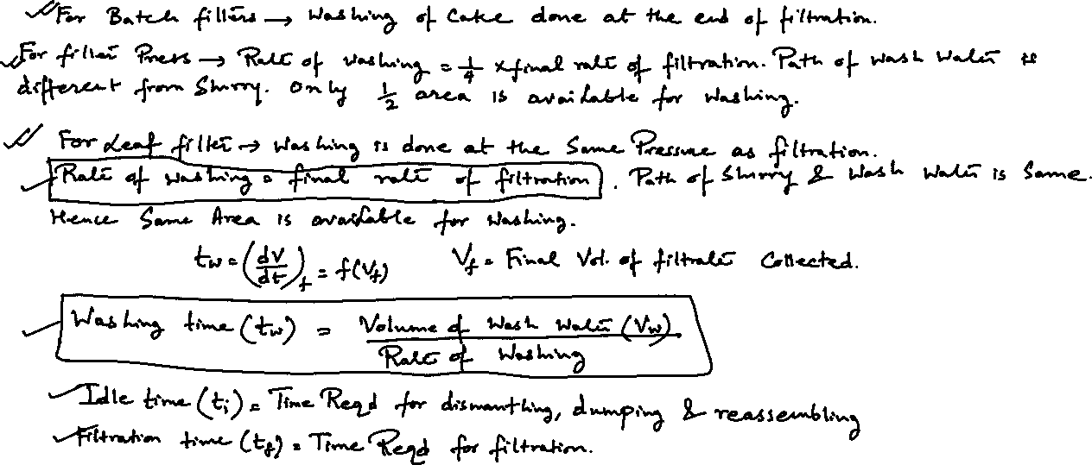
Washing Rates

Slide 12
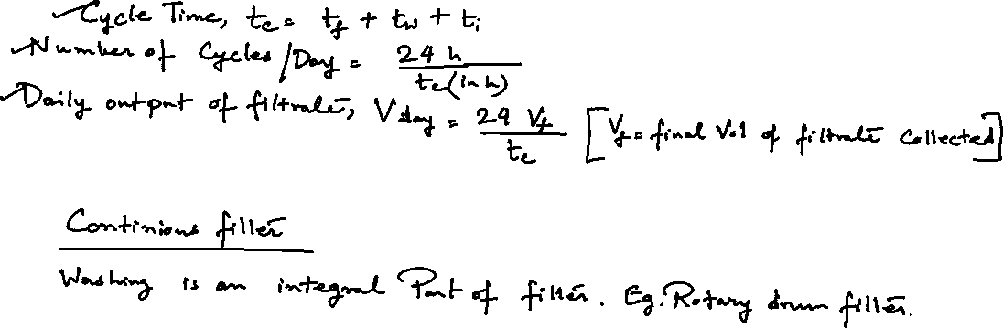
Washing Rates

Slide 13
References
Smith, J., Harriott, P., McCabe, W. (2005). Unit Operations of Chemical Engineering. Colombia: McGraw-Hill Education.
Swain, A. K., Patra, H., & Roy, G. K. (2011). Mechanical operations. Tata McGraw Hill.

